Slide 1
JavaScript APIs*
*Let’s be honest, this is the stuff that makes HTML5 awesomerer!

Slide 2

JavaScript APIs
Description

Slide 3
Agenda
Geolocation
Canvas
Web Workers and Web Sockets
Web Storage and Indexed DB
Drag and Drop
History API

Slide 4
Semantic Markup*
*Alas, poor <div>, I hardly knew ye.
Notes:
You’ll recall that semantics was one of our five words, because it’s important to understand why HTML5 introduces changes to the HTML5 markup specification, both by eliminating unneeded cruft and adding more semantically-rich elements.

Slide 5
A Sample XHTML Document
<!DOCTYPE html PUBLIC "-//W3C//DTD XHTML 1.0 Strict//EN" "http://www.w3.org/TR/xhtml1/DTD/xhtml1-strict.dtd">
<html>
<head>
<meta http-equiv="content-type" content="text/html;
charset=utf-8">
</head>
<body>
<p> XHTML :/ </p>
</body>
</html>
Notes:
Let’s talk about unneeded cruft, first. You’ve seen this, no doubt. This is the smallest XHTML document that I could create, and it still barely fits in this slide. HTML5 changes this drastically, and you can use those changes today in any browser, even older ones. You pages will still render.

Slide 6
A Sample HTML5 Document
<!DOCTYPE html>
<html>
<head>
<meta charset="utf-8">
<title> Hello </title>
</head>
<body>
<p> HTML5! </p>
</body>
</html>
Notes:
This is all you need to create a valid HTML5 document. The Doctype and meta http-equiv tags been changed. It’s nice to get that cruft out of the way.

Slide 7
28 New Elements
article | footer | rt
aside | header | ruby
audio | hgroup | section
canvas | keygen | source
command | mark | summary
datalist | meter | time
embed | output | wbr
figcaption | progress
figure | rp
article | footer | rt
aside | header | ruby
audio | hgroup | section
canvas | keygen | source
command | mark | summary
datalist | meter | time
embed | output | wbr
figcaption | progress
figure | rp
Notes:
So we’re gotten some cruft out of our markup. We’ve also added new elements.
Here’s a list of all of the new markup elements defined in HTML5. I’m not going to cover most of these today, though I will briefly cover the highlighted items. There is tons of information about them available online and in great books like “HTML5 Up and Running” and “Introducing HTML5.” Remember that word “semantic?” The beautiful thing about this list is that most of these probably mean exactly what you think they mean.

Slide 8






Browser Support for Semantic Markup
 |  |  |  |  | Mobile
9 | 6 | 4 | 11.1 | 5 | 9 | 2.2 | 4

Slide 9
Semantic Markup
demo
Notes:
Let’s take a look at some of these new elements now.

Slide 10
Audio and Video*
*Media without Plugins, but lots of Codecs
Notes:
Next, we’ll look at two related elements that standardize how rich media is presented to users through the browser.

Slide 11

Media on Your Page… No Plugins Required.
<video id=“video" controls autoplay>
<source src="video.mp4" type="video/mp4“ />
</video>
document.getElementById("video").play();
<audio id="audio" src="sound.mp3" controls></audio> document.getElementById("audio").muted = false;
Notes:
Audio and Video are some of the most talked about new elements and, on face, they are very easy to use. Practically though, Codecs complicate both audio and video because even though all browsers implement these new tags, not all agree on the proper Codecs to support. So using audio and video today is possible, but you should, as a best practice, provide at least 3 sources of video(WebM, MP4 and Ogg Vorbis) and 2 of Audio (mp3, Ogg Theora) and fallback to Silverlight or flash for browsers that don’t support Video and Audio tags.
[Image captured from my computer]

Slide 12
Browser Support for Audio and Video
 |  |  |  |  | Mobile
9 | 4 | 3.5 | 10.5 | 4 | 9 | 2.3 | 4

Slide 13
<audio> and <video>
demo
Notes:
Let’s take a look at using audio and video, and at how to provide fallback.

Slide 14
HTML5 Forms*
*Finally, support for the data-entry we’ve been doing for 15 years

Slide 15
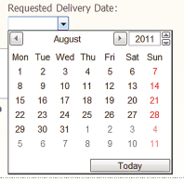
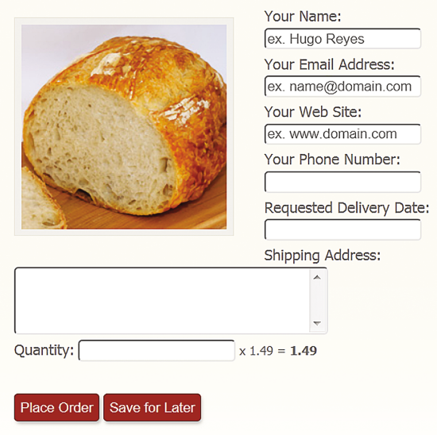

Name: <input type="text” id="orderName" required autofocus placeholder="ex. Hugo Reyes" />
Email:<input type="email" id="orderEmail" required placeholder="ex. name@domain.com" />
Tel: <input type="tel" id="orderTelephone" pattern="\(\d\d\d\) \d\d\d\-\d\d\d\d" title="(xxx) xxx-xxxx" />
<input type="submit" value="Place Order" />
<input type="submit" formnovalidate value="Save for Later" id="saveForLater" />

Slide 16
Browser Support for Forms
 |  |  |  |  | Mobile
10 | 4 | 4 | 9 | 4 | ? | ? | 5

Slide 17
Custom Data Attributes*
*Roll Your Own (Valid) Markup

Slide 18
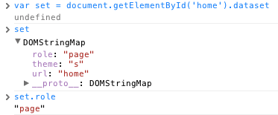
Embed custom data with data-*
<ol id=“songs” data-totaltime=“34m23s”>
<li data-length=“2m11s”>Beyond the Sea</li>
…
</ol>
$(‘songs’).dataset[‘totaltime’] // 34m23s
Notes:
Custom data attributes are intended to store custom data private to the page or application, for which there are no more appropriate attributes or elements. Intended to be used by scripts in the site.
Common uses include:
Unobtrusive Validation in ASP.NET MVC
jQuery Mobile
Knockout JS

Slide 19
Browser Support for “Data-”
 |  |  |  |  | Mobile
9 | 7 | 6 | 11 | 5.1 | 9 | 2.3 | 5

Slide 20
“data-*”
demo
Notes:
Go to http://validator.nu/ and create a arbitrary attribute and try to validate the page
Append data- and attempt to validate again, it will work this time.
Now let’s look at real-world uses of data-. jQuery mobile makes heavy use of Data- attributes, and we can take a look and how we can query these
Go to jQueryMobile.com and show the gallery
Go to http://www.slideshare.net/mobile or m.opentable.com and open the Chrome Dev tools
Open the console and select an element by ID to show working with Data-* attributes

Slide 21
SVG*
*Canvas’ (eXtensible) Big Brother

Slide 22

<svg> + <html> = Stylable, Scriptable SVG
<svg xmlns="http://www.w3.org/2000/svg" viewBox="0 0 220.5 199.5">
<title>HTML5 CSS Styling Logo</title>
<path d="M32.8,0L25.4,37.0 176.0,37.0 171.3,60.9 20.6,60.9 13.3,97.9 163.9,97.9 155.5,140.1 94.8,160.2 42.2,140.1 45.8,121.8 8.8,121.8 0,166.2 87.0,199.5 187.3,166.2 200.6,99.4 203.3,86.0 220.4,0z"/>
</svg>
<style>
svg path {
fill: navy;
}
</style>
Notes:
SVG is an older graphics specification, but a powerful one. SVG, or Scalable Vector Graphics, is actually a family of specifications around providing an XML-based file-format for two-dimensional vector graphics.
SVG can be represented as a standalone .svg file or embedded as xml into your markup. Inline SVG gives you a powerful way to work with vector graphics on you page, and because it’s markup and not a binary image, you can manipulate and style anything in the SVG element and you can use script to interact with the element, much like you do with canvas.
[Image captured from my computer]

Slide 23
Browser Support for SVG
 |  |  |  |  | Mobile
9 | 4 | 3 | 9 | 3.2 | 9 | 3 | 3.2

Slide 24
<svg>
demo
Notes:
Let’s take a look at canvas and svg in action.

Slide 25
Questions?

Slide 26
Lab Instructions
Make sure you’ve cloned or downloaded the Labs repo from github.com/csell5/HTML5-Compiler
Go to http://bit.ly/wTRzaS and follow the instructions from the readme
Alternatively, open readme.md in the “4- JavaScript API” folder

